Slide 1

gitlab Runner
by Vishwanath MS

Slide 2



GitLab Runner Deep Dive – Overview
This section provides a high-level introduction to GitLab Runners, explaining their purpose, importance in CI/CD, and fundamental concepts.
What is a GitLab Runner?
Why are Runners Important in CI/CD?
Key Concepts
A GitLab Runner is an agent that executes your CI/CD jobs within a GitLab pipeline.
Jobs: The smallest units of work in a pipeline, defining what to do.
Runners are crucial because they perform the actual work defined in your .gitlab-ci.yml file.
Pipelines: A sequence of jobs that orchestrate your entire CI/CD workflow.
It connects your GitLab instance to the infrastructure where your code is built, tested, and deployed.
They provide the necessary execution environment.
Executors: The method a Runner uses to run a job, such as Docker, Shell, or Kubernetes.
It effectively acts as the workhorse for your automation tasks.
They enable fast, consistent, and automated delivery of your software without manual intervention.

Slide 3
What is a GitLab Runner?
Open-Source Application
Job Execution
A GitLab Runner is an open-source application designed to work seamlessly with GitLab CI/CD pipelines.
It is responsible for executing the CI/CD jobs defined in your .gitlab-ci.yml file.
GitLab Communication
Flexible Infrastructure
The Runner securely communicates with your GitLab server to fetch job details and send back results.
It can be installed and run on diverse infrastructures, including local machines, virtual machines, cloud instances, and containers.

Slide 4




Runner Architecture & Workflow
Runner Registration
Job Assignment
Environment Launch
Execution & Reporting
The GitLab Runner establishes a secure, persistent connection with the GitLab instance for job communication.
GitLab assigns pending CI/CD jobs to the Runner, sending detailed instructions from the .gitlab-ci.yml file.
The Runner's configured executor provisions the necessary environment (e.g., Docker, Shell, Kubernetes) to run the assigned job.
The job's scripts are executed, with logs streamed and the final status (success/failure) reported back to GitLab.

Slide 5



Types of GitLab Runners
Shared Runners
Specific Runners
Group Runners
Available to all projects within a GitLab instance.
Dedicated to a particular project or group of projects.
Registered at the group level.
Available for all projects within that group and its subgroups.
Managed by the GitLab administrator.
Provide greater control over the execution environment, dependencies, and security.
Balance flexibility of Specific Runners with shared access of Shared Runners.
Offer a convenient, 'out-of-the-box' solution for many teams.
Ideal for sensitive projects or those with unique requirements.
Simplify management for teams working on multiple related projects.
Suitable for projects that don't require specialized environments or strict isolation.

Slide 6
Shell Executor
Direct Execution
Setup & Debugging
The Shell Executor runs CI/CD jobs directly on the local shell environment of the machine where the Runner is installed, leveraging its existing software and configurations.
It is relatively simple to set up, requiring minimal configuration. Debugging issues can also be straightforward as you're working directly on the host machine.
Non-Containerized Builds
Isolation & Pollution
This executor is well-suited for projects that do not rely on containerized environments for their build processes, or when you need direct access to host system resources.
A key limitation is the lack of strong job isolation. There's a potential for "pollution" where artifacts or environmental changes from one job can affect subsequent jobs on the same Runner.

Slide 7
Docker Executor
Clean & Isolated
Reproducible Environments
Each job runs in a brand-new, temporary Docker container, ensuring strong isolation and preventing interference between jobs.
Docker guarantees consistent build and test environments, leading to reliable and predictable code behavior across runs.
Flexible Image Selection
Advanced Configurability
Easily choose different Docker images for each job in your .gitlab-ci.yml, offering precise control over tools and dependencies.
Supports advanced settings like Docker-in-Docker for complex builds and custom Docker images for managing intricate dependencies.

Slide 8
Kubernetes Executor
Container Orchestration
Dynamic Scalability
Cloud-Native Integration
The Kubernetes Executor schedules each CI/CD job as a dedicated Pod within your Kubernetes cluster, leveraging its powerful orchestration and resource management capabilities.
Provides exceptional scalability by dynamically provisioning environments on demand. Jobs run in isolated, temporary Pods, ensuring a clean and consistent state for every execution.
Perfect for larger teams and cloud-native organizations, as it seamlessly integrates CI/CD workflows with existing Kubernetes infrastructures, optimizing resource utilization.

Slide 9



Comparing Executors
Shell Executor
Docker Executor
Kubernetes Executor
Executes jobs directly on the host machine. Offers low isolation and is best for simple local builds due to its low setup complexity.
Runs each job in a dedicated Docker container. Provides high isolation and is the most common choice for consistent environments with medium setup complexity.
Schedules each job as a Pod within a Kubernetes cluster. Offers very high isolation and is ideal for large, scalable cloud-native use cases despite its high setup complexity.

Slide 10
Registering a Runner
Configure Runner
Run Registration Command
You will be prompted to provide essential information for connecting your Runner to GitLab:
Install Runner Binary
Use the command line interface to initiate the registration process:
Begin by downloading and installing the gitlab-runner executable on your chosen host machine (e.g., Linux, Windows, macOS).
GitLab instance URL
gitlab-runner register
Registration token (from your project, group, or instance settings)
Executor type (e.g., Shell, Docker, Kubernetes)
A descriptive name and relevant tags for categorization

Slide 11
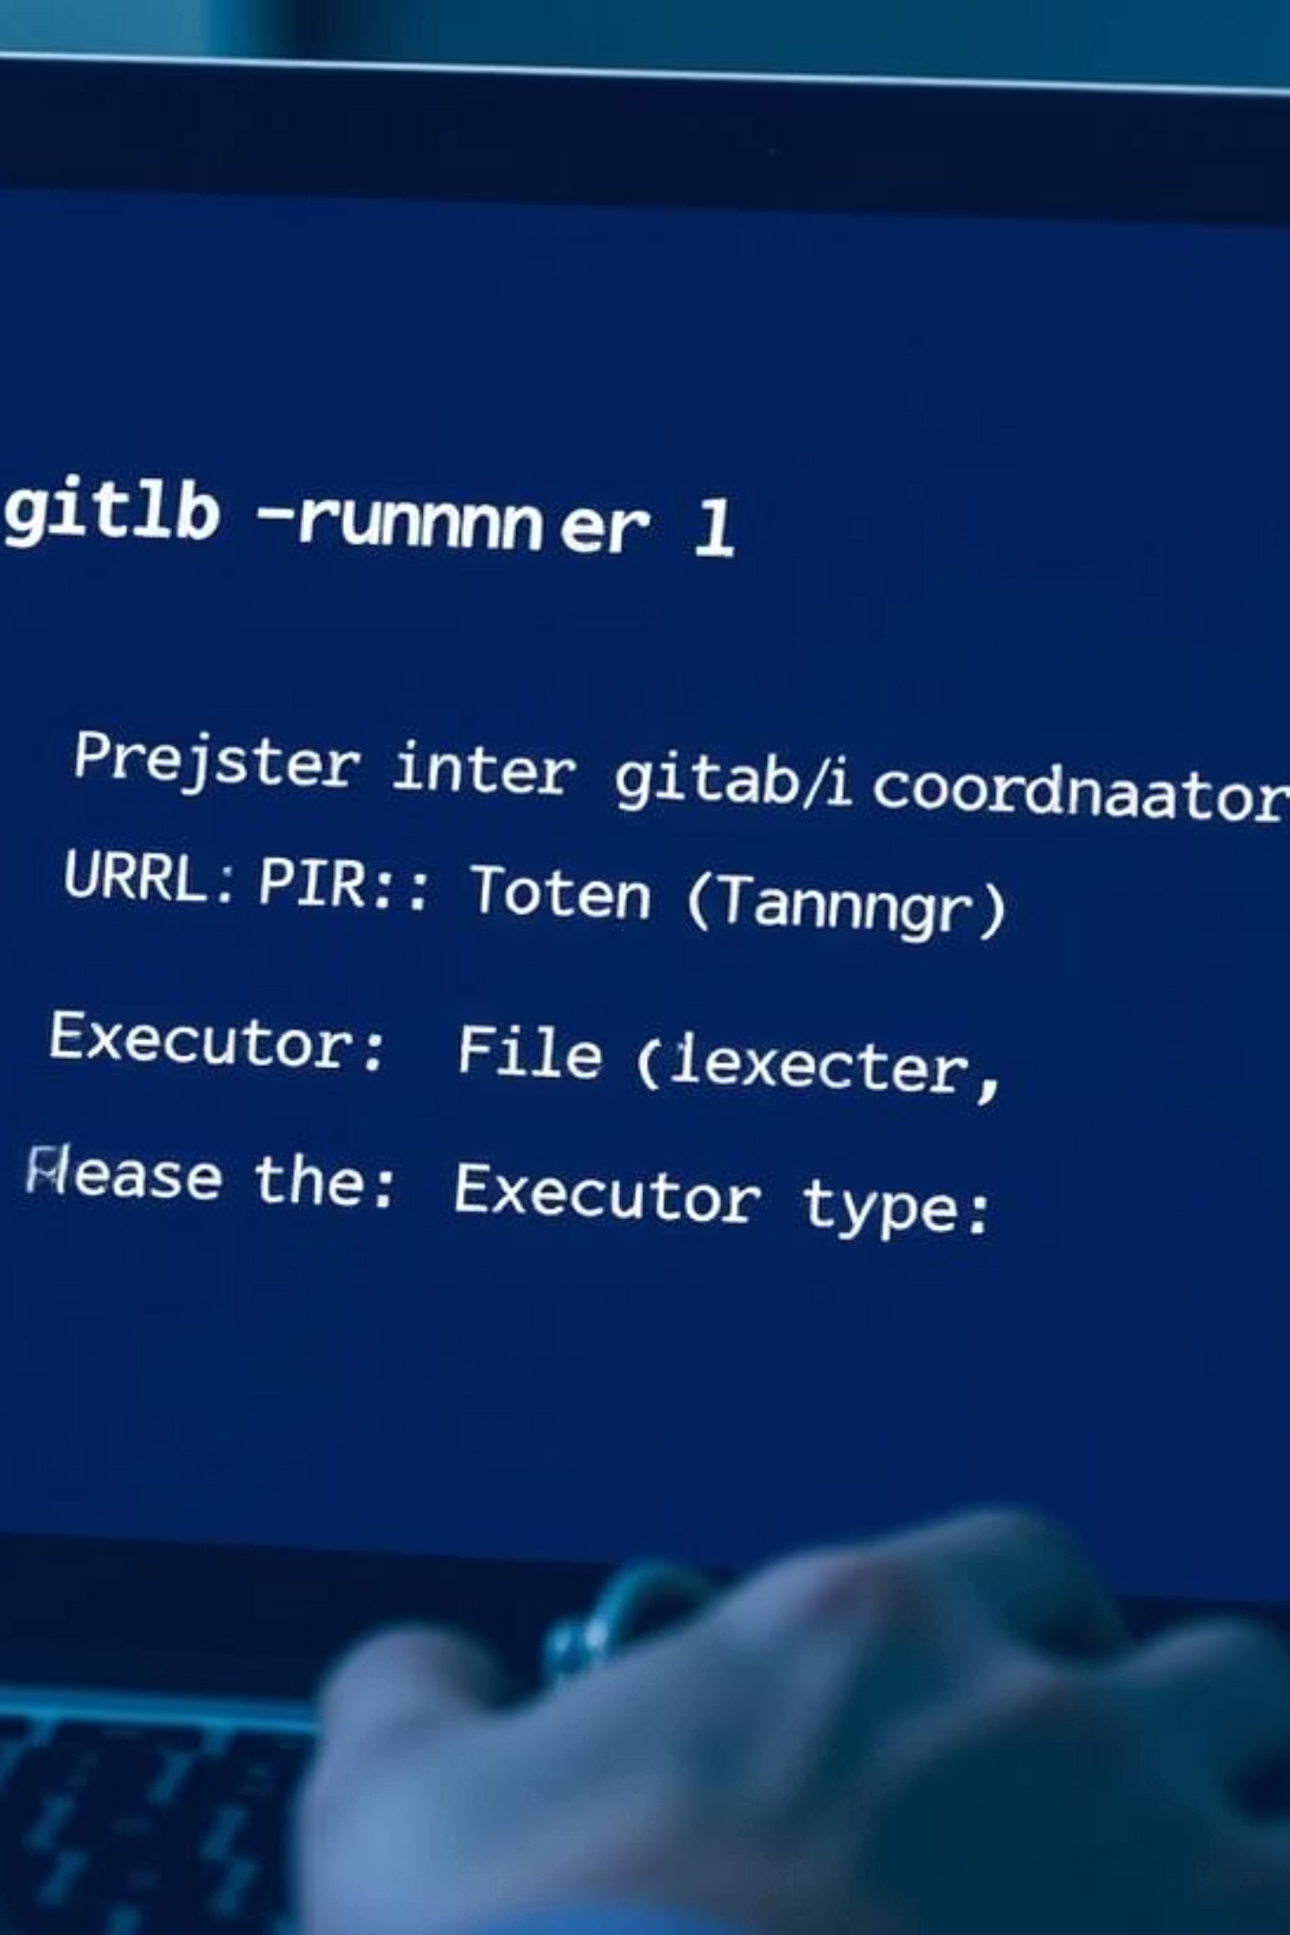

Runner Registration Demo (Shell Example)
To register a GitLab Runner, you primarily use the command-line interface. This demo focuses on the Shell executor, demonstrating the steps to connect your local machine as a Runner.
sudo gitlab-runner register
The command-line interface will prompt you for the following essential details to complete the registration process:
Enter your GitLab instance URL (e.g., https://gitlab.com/ or your self-hosted instance URL)
Enter the registration token (found in your GitLab project, group, or instance CI/CD settings)
Provide a descriptive name for your Runner and relevant tags for categorization
Select the executor type (e.g., shell, docker, kubernetes)

Slide 12



Registering a Docker Runner – Example
To register a GitLab Runner configured to use the Docker executor, you can provide all necessary parameters directly in the registration command, avoiding interactive prompts.
sudo gitlab-runner register \ --url https://gitlab.com/ \ --registration-token <TOKEN> \ --executor docker \ --description "docker-runner" \ --docker-image "alpine:latest"
This command specifies:
--executor docker: Instructs the Runner to use Docker for job execution, ensuring isolation and reproducibility.
--docker-image "alpine:latest": Sets the default Docker image (alpine:latest in this case) that jobs will use if no specific image is defined in the .gitlab-ci.yml file.

Slide 13



Registering a Kubernetes Runner – Example
Deploying a GitLab Runner configured to use the Kubernetes executor is typically managed through Helm, the package manager for Kubernetes. Helm streamlines the process of defining, installing, and upgrading applications within your cluster.
helm repo add gitlab https://charts.gitlab.iohelm install gitlab-runner gitlab/gitlab-runner \ --set gitlabUrl=https://gitlab.com/ \ --set runnerRegistrationToken=<TOKEN>
This Helm command:
Adds the GitLab Helm repository: helm repo add gitlab https://charts.gitlab.io registers the official GitLab charts.
Installs the GitLab Runner: helm install gitlab-runner gitlab/gitlab-runner deploys the Runner as a set of Kubernetes resources.
Sets GitLab URL and Registration Token: The --set flags pass crucial configuration like your GitLab instance URL and the Runner's registration token, automating the connection to your GitLab project or group.

Slide 14
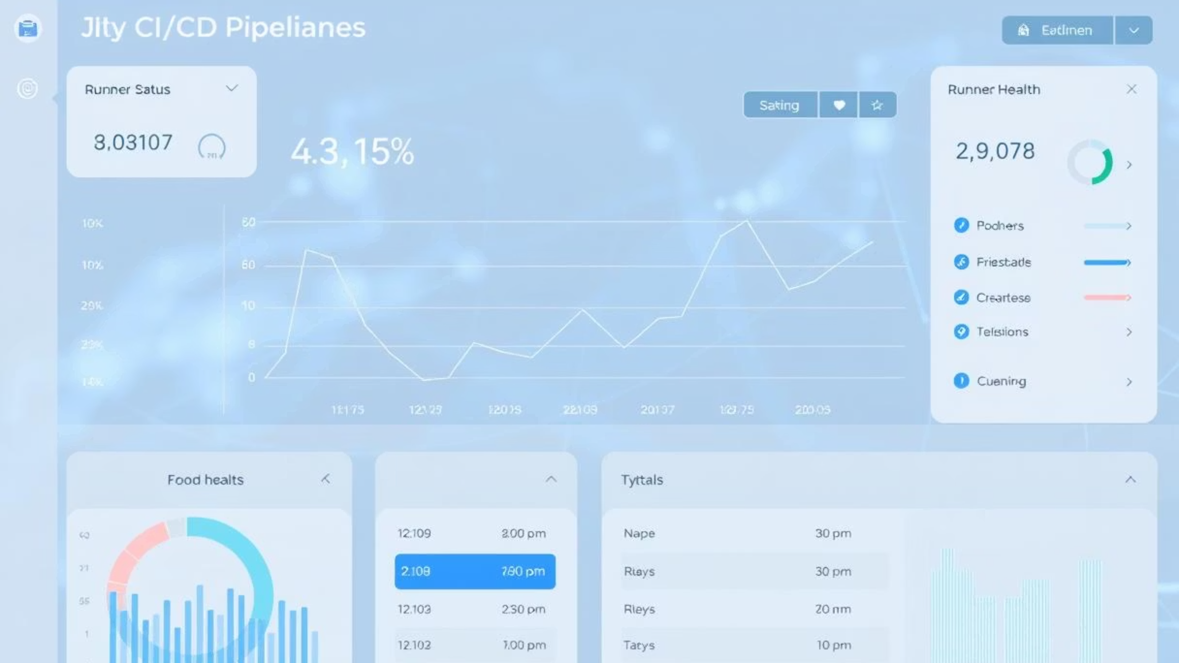



Runner Visibility & Management
Once registered, GitLab Runners are visible and manageable directly within the GitLab UI, providing centralized control over your CI/CD infrastructure.
Check Registered Runners
Manage Status & Tags
Security Best Practices
Navigate to Project > Settings > CI/CD > Runners to view a comprehensive list of all registered Runners associated with your project, group, or instance.
From the UI, you can easily enable or disable Runners, assign descriptive tags for better job routing, and check their current status (online/offline).
Regularly review active Runners. Unregister unused Runners, and ensure sensitive tokens are securely managed. Avoid running untrusted code on Runners with broad permissions.

Slide 15



Best Practices for GitLab Runners
Optimizing your GitLab Runner setup is crucial for efficient, secure, and scalable CI/CD pipelines. Adhering to best practices ensures reliability and performance.
Tag Runners for Job Routing
Use Isolation for Untrusted Code
Limit Shared Runner Use
Assign descriptive tags (e.g., docker, frontend, production) to your Runners. This allows precise control over which jobs run on specific Runners, ensuring compatibility and resource allocation.
For jobs executing untrusted or potentially malicious code, always use Executors providing strong isolation, such as Docker or Kubernetes. Shell executors should be reserved for trusted environments only.
While convenient, shared Runners on gitlab.com might not be suitable for sensitive data or specific resource needs. Consider private or specific Runners for such cases.

Slide 16


Best Practices for GitLab Runners (Continued)
Regularly Update Runners
Monitor Runner Resource Usage
Keep your GitLab Runner installations up-to-date. Regular updates bring performance improvements, bug fixes, and critical security patches, protecting your CI/CD environment.
Implement monitoring for your Runners to track CPU, memory, and disk usage. This helps identify bottlenecks, optimize resource allocation, and prevent job failures due to insufficient resources.

Slide 17

Troubleshooting & Tips
Efficiently manage and troubleshoot your GitLab Runners with these essential tips and commands.
Common Errors & Logs
Useful CLI Commands
For most issues, start by checking the Runner logs, typically located at /var/log/gitlab-runner/ on Linux systems. Look for error messages related to connectivity, permissions, or executor issues.
gitlab-runner list: View all registered Runners on the current machine.
gitlab-runner verify: Check if Runners are still connected to GitLab and valid.
gitlab-runner restart: Restart the Runner service after configuration changes.
For large-scale deployments, consider Runner autoscaling with Docker Machine or Kubernetes. This allows Runners to dynamically provision or de-provision compute resources based on job queue demand, optimizing cost and performance.

Slide 18

Key Takeaways & Further Resources
CI/CD Backbone
Strategic Executor Choice
Security & Maintenance
GitLab Runners are fundamental to automating your CI/CD pipelines, executing jobs directly on your infrastructure.
Prioritize keeping your Runners secure with proper permissions, and ensure they are regularly updated for optimal performance and protection.
Carefully select the appropriate executor (Shell, Docker, Kubernetes) based on your team size, project needs, and desired isolation levels.
For in-depth information, refer to the Official GitLab Runner Documentation.

